Slide 1

Binary Search Tree

Slide 2
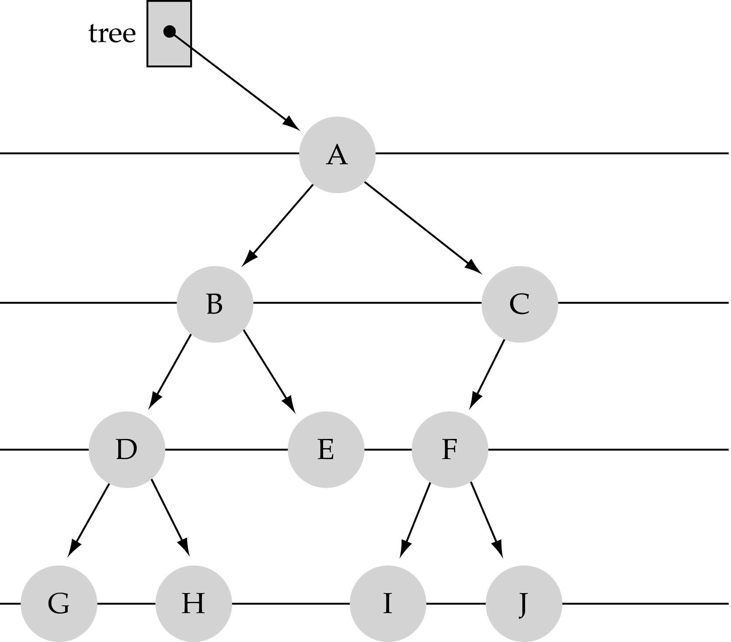
What is a Binary Tree?
Property 1: Each node can have up to two successor nodes.

Slide 3
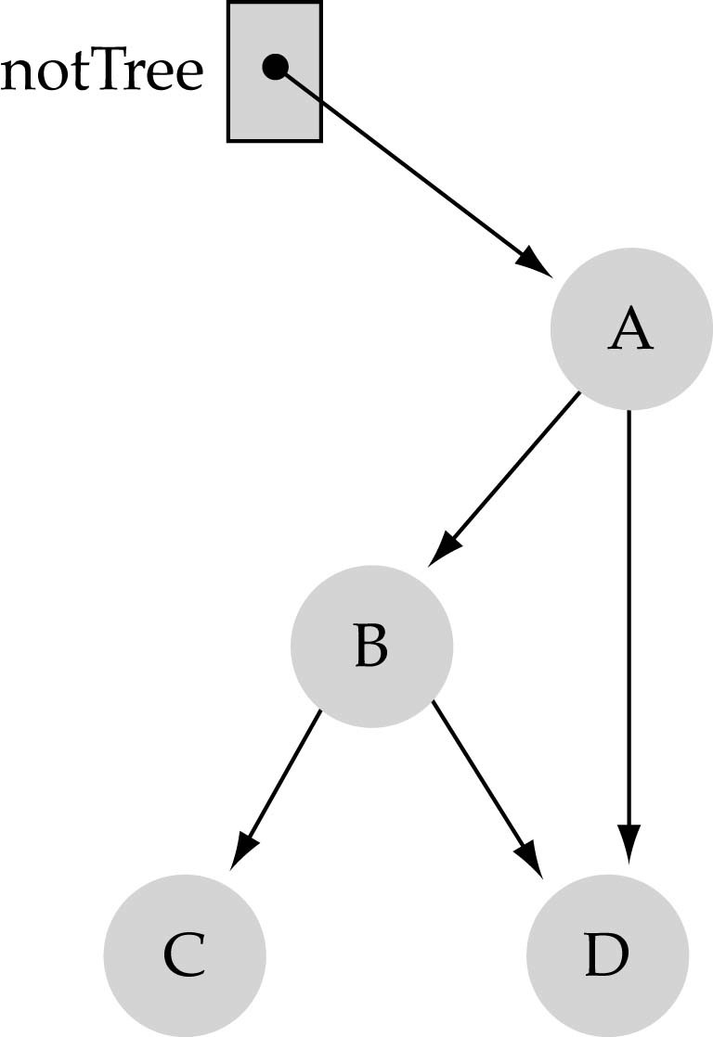
What is a Binary Tree?
Property 2: a unique path exists from the root to every other node

Slide 4

A Binary Tree

Slide 5
Binary Tree
typedef struct tnode *ptnode; typedef struct node {
short int key; ptnode right, left;
} ;

Slide 6
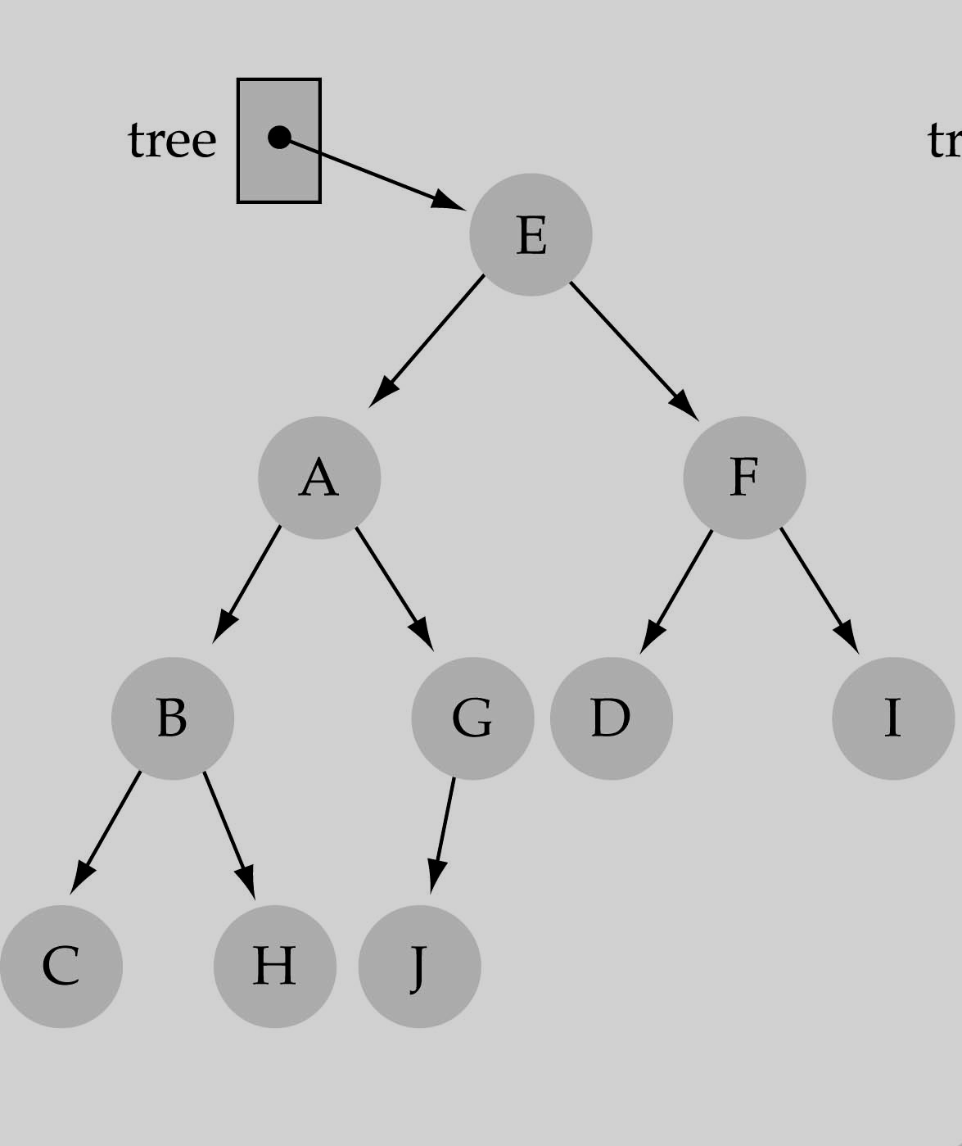
Basic Terminology
The successor nodes of a node are called its children
The predecessor node of a node is called its parent
The "beginning" node is called the root (has no parent)
A node without children is called a leaf

Slide 7
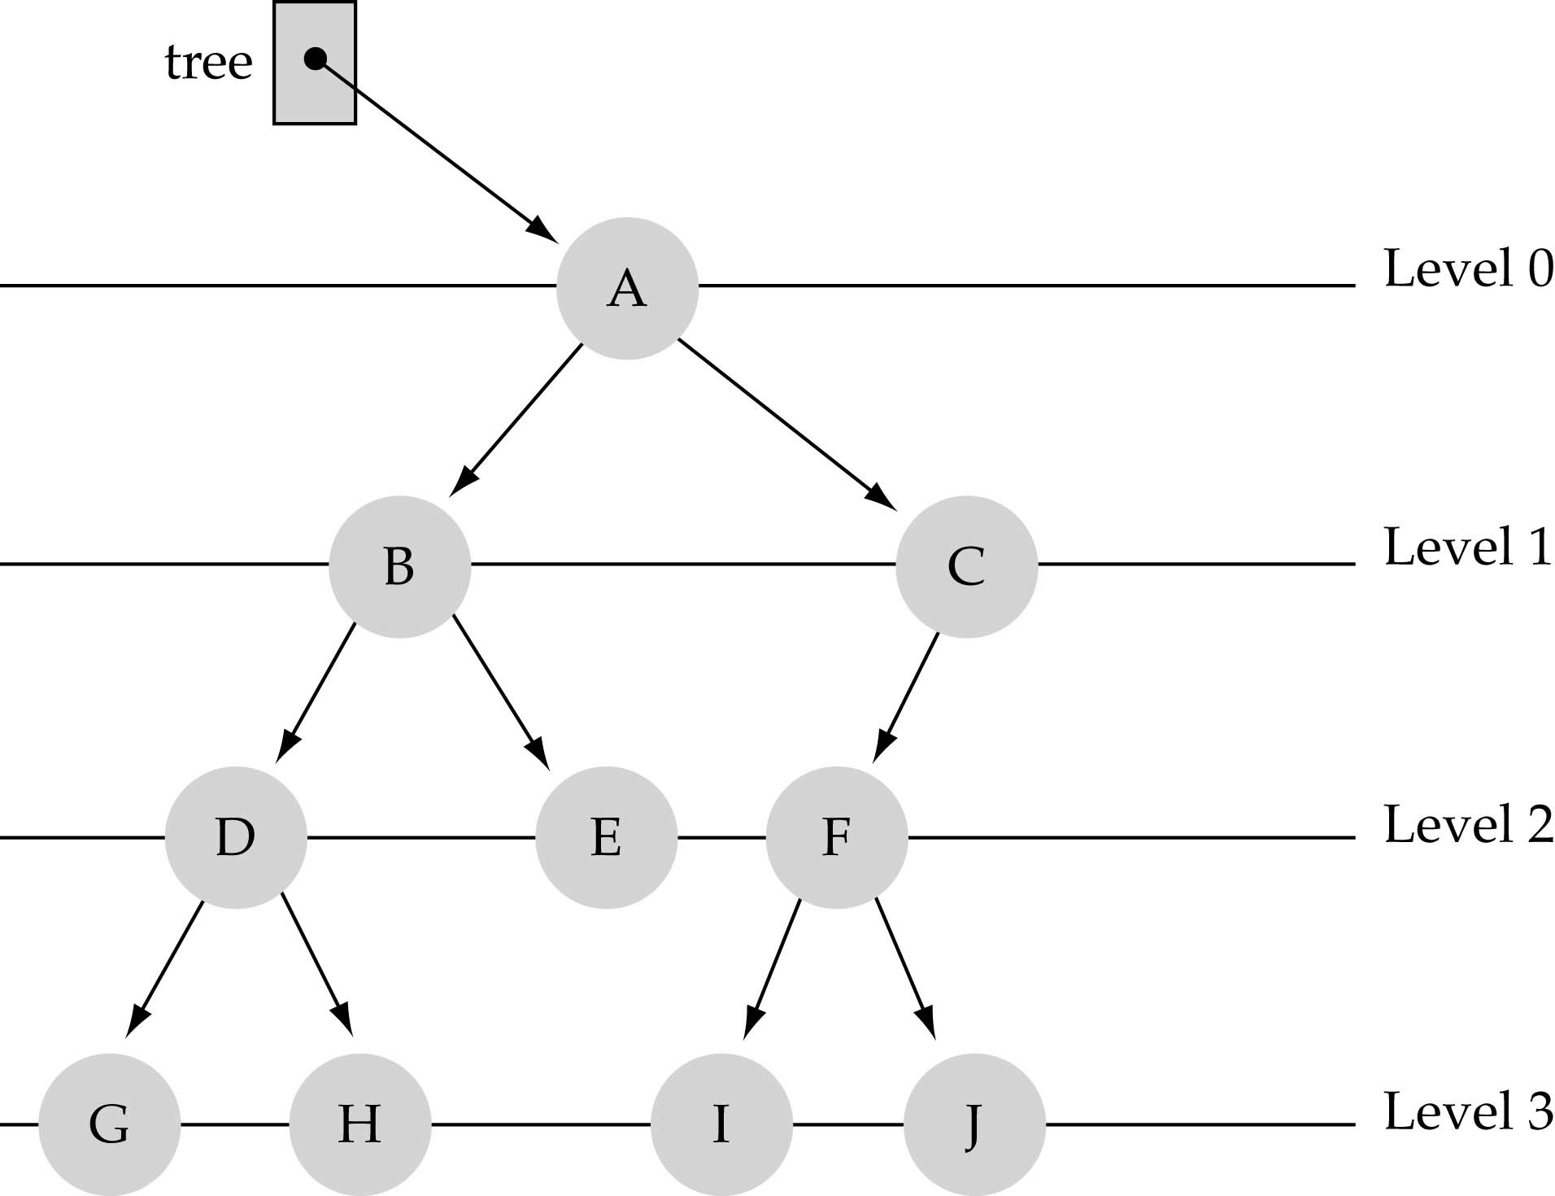
Basic Terminology
Nodes are organize in levels (indexed from 0).
Level (or depth) of a node: number of edges in the path from the root to that node.
Height of a tree h: #levels = L (some books define h as
number of levels-1).
not full!
Full tree: every node has exactly two children and all the leaves are
on the same level.

Slide 8
What is the max number of nodes at any level l ?
The maximum number of nodes at any level l is less than or equal to 2^{l} where l=0, 1, 2, 3,….. L-1
≤ 2⁰
≤ 2¹
≤ 2²
≤ 2³

Slide 9
N = 2⁰ + 2¹ + ... + 2^{h−1} = 2^{h} − 1
l=0 l=1 l=h-1
What is the total number of nodes N of a full tree with height h?
Derived according to the geometric series:
n−1
∑
i=0
i
n
x⁰ + x¹ + ... + x^{n−1} =
x =
x −1
x−1

Slide 10
What is the height h
of a full tree with N nodes?
₂h
−1 = N
⇒ 2^{h} = N + 1
⇒ h = log(N + 1) → O(log N )

Slide 11
Why is h important?
The Tree operations like insert, delete, retrieve etc. are typically expressed in terms of the height of the tree h.
So, it can be stated that the tree height h determines running time!

Slide 12
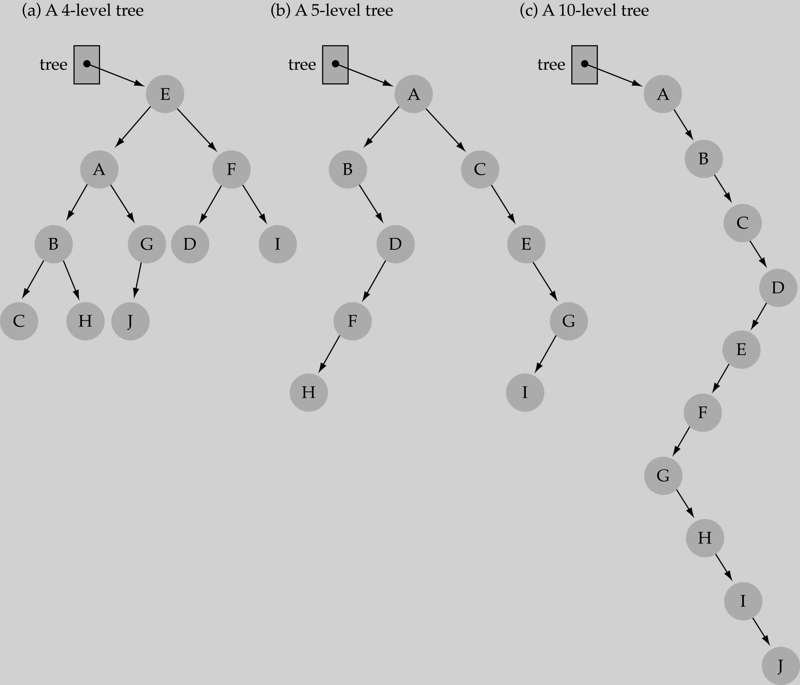
What is the max height of a tree with N nodes?
N (same as a linked list)
What is the min height of a tree with N nodes?
log(N+1)

Slide 13
Binary Search
Suppose DATA is an array which is sorted in increasing numerical order and we want to find the location LOC of a given ITEM in DATA. Then there is an extremely efficient searching algorithm called Binary Search.

Slide 14
Binary Search
Consider that you want to find the location of some word in a dictionary.
I guess you are not fool enough to search it in a linear way or in other words apply linear search. That is no one search page by page from the start to end of the book.
Rather, I guess you will open or divide the dictionary in the middle to determine which half contains the word.
Then consider new probable half and open or divide that half in the middle to determine which half contains the word. This process goes on.
Eventually you will find the location of the word and thus you are reducing the number of possible locations for the word in the dictionary.

Slide 15

How to search a binary tree?
Start at the root
Search the tree level by level, until you find the element you
are searching for or you reach
a leaf.
Is this better than searching a linked list?
No ◊◊ O(N)

Slide 16
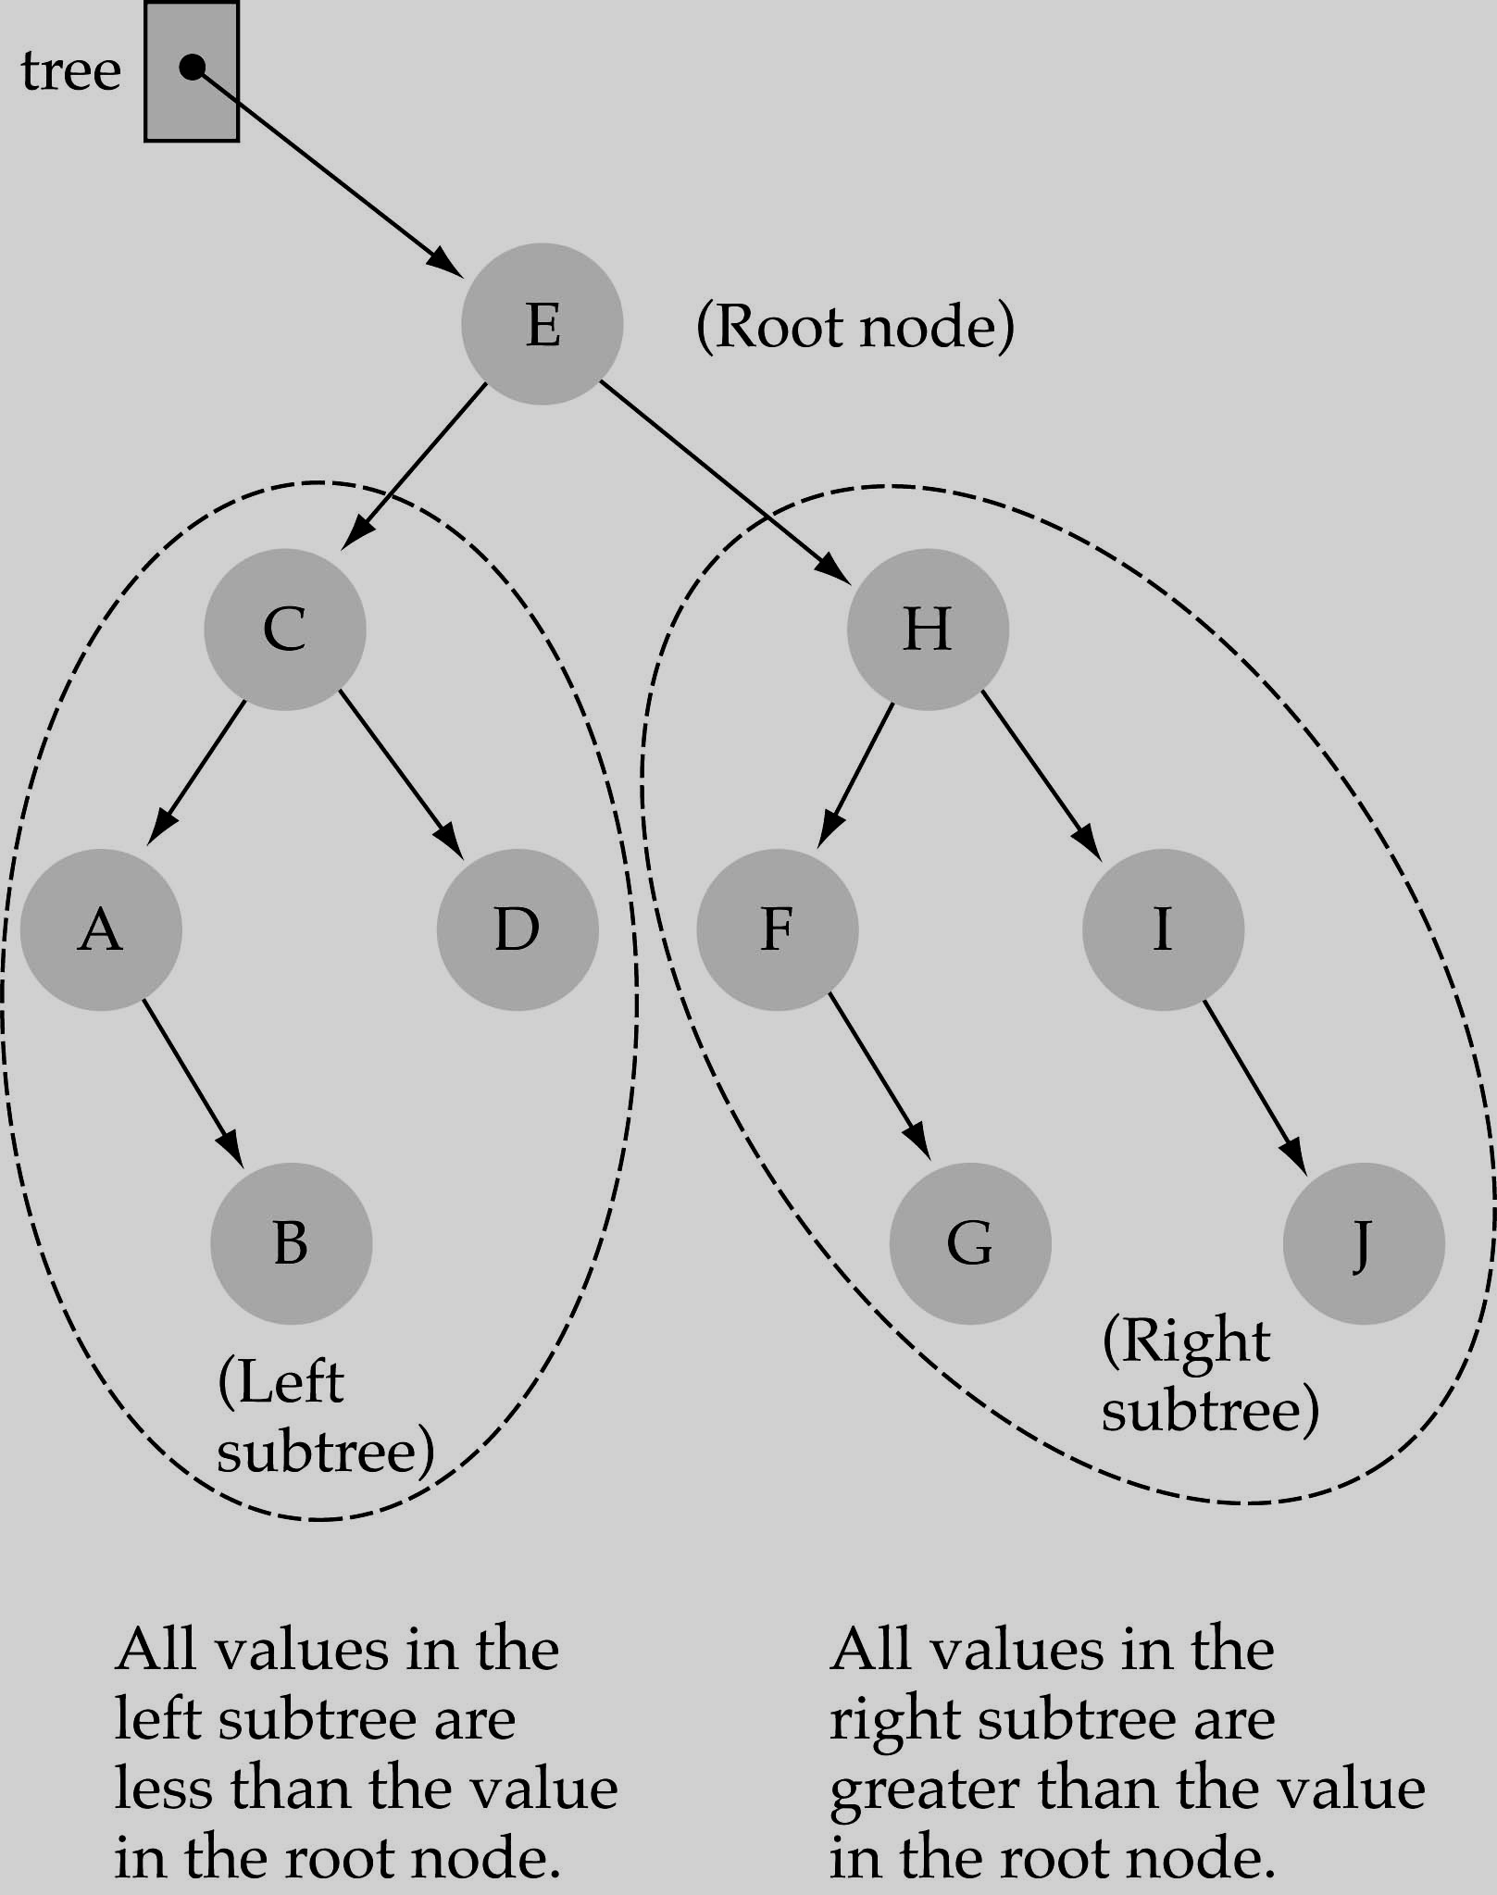
Binary Search Trees
Binary Search Tree Property:
The value stored at
a node is greater than the value stored at its
left child and less than the value stored at its
right child

Slide 17
Binary Search Trees
♣
In a BST, the value stored at the root of a subtree is greater than any value in its left subtree and less than any value in its right subtree!

Slide 18
Binary Search Trees
Where is the smallest element?
Ans: leftmost element
Where is the largest element?
Ans: rightmost element

Slide 19
How to search a binary search tree?
Start at the root
Compare the value of the item you are searching for with the value stored at the root
If the values are equal, then item found; otherwise, if it is a leaf node, then not found

Slide 20
How to search a binary search tree?
If it is less than the value stored at the root, then search the left subtree
If it is greater than the value stored at the root, then search the right subtree
Repeat steps 2-6 for the root of the subtree chosen in the previous step 4 or 5

Slide 21
How to search a binary search tree?
Is this better than searching a linked list?
Yes !! ◊ ◊ O(logN)

Slide 22
Difference between BT and BST
A binary tree is simply a tree in which each node can have at most two children.
A binary search tree is a binary tree in which the nodes are assigned values, with the following restrictions :
No duplicate values.
The left subtree of a node can only have values less than the node
The right subtree of a node can only have values greater than the node and recursively defined
The left subtree of a node is a binary search tree.
The right subtree of a node is a binary search tree.

Slide 23
Binary Tree Search Algorithm
TREE-SEARCH(x,k)
If x==NIL or k==x.key
return x
If k < x.key
4. return TREE-SEARCH(x.left,k) 5.else return TREE-SEARCH(x.right,k)

Slide 24
BST - Pseudo code
if the tree is empty
return NULL
else if the key value in the node(root) equals the target return the node value
else if the key value in the node is greater than the target return the result of searching the left subtree
else if the key value in the node is smaller than the target return the result of searching the right subtree

Slide 25
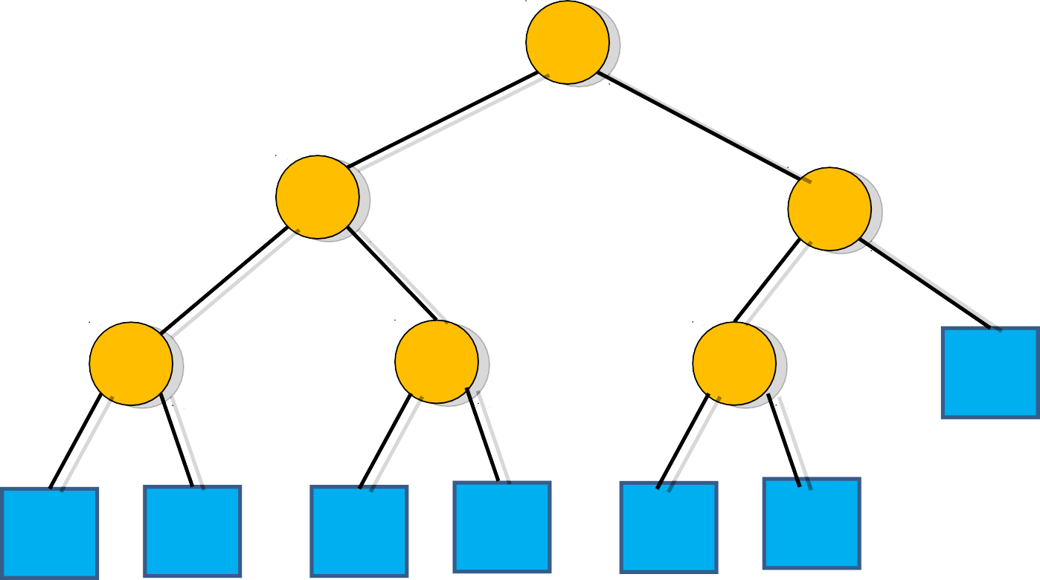
Binary Tree Search Algorithm
Example: key =4 then find(4)
6
Call TREE-SEARCH(x,k)
2
9
1
4
8

Slide 26
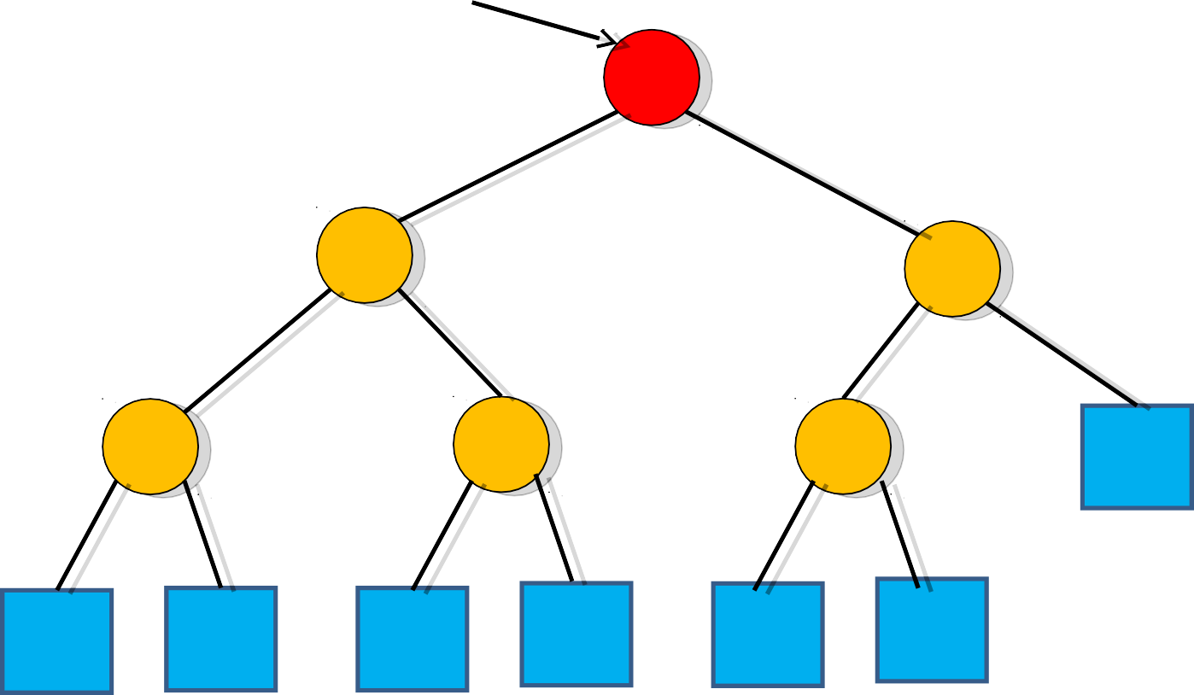
Binary Tree Search Algorithm
x=root
Example: k =4 and x=root
Call TREE-SEARCH(root,4) Now x.key=6 then k<x.key
So call TREE-SEARCH(x.left,k)
9
6
2
1
4
8

Slide 27
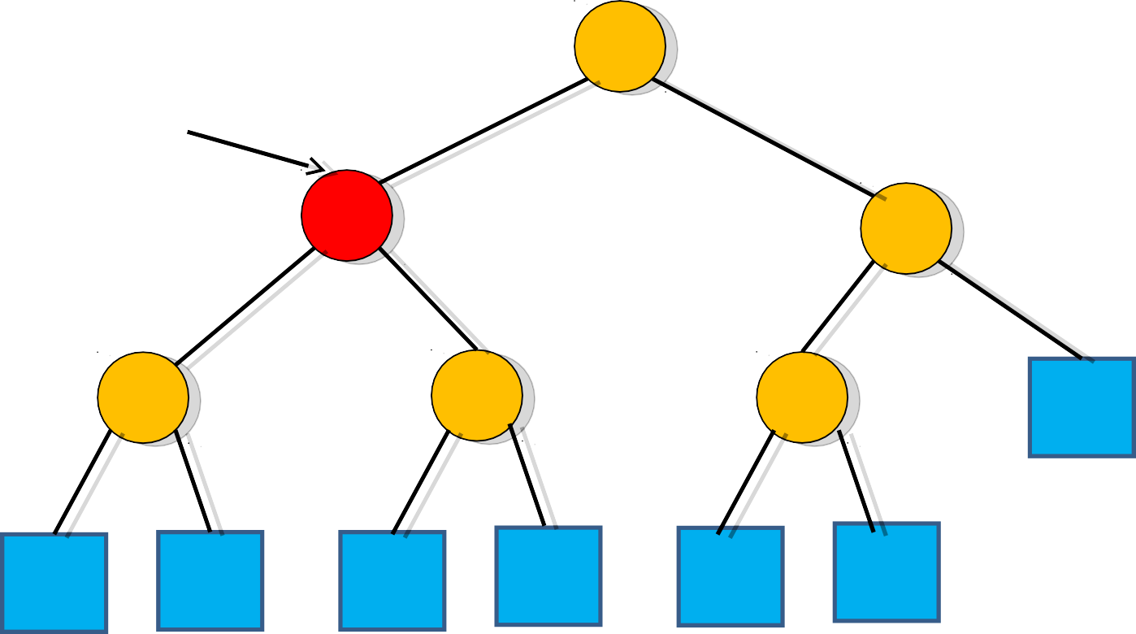
Binary Tree Search Algorithm
Example: k =4 and x=root.left Call TREE-SEARCH(x,4)
6
x=root.left
Now x.key=2 then k>x.key TREE-SEARCH(x.right,k)
9
2
1
4
8

Slide 28
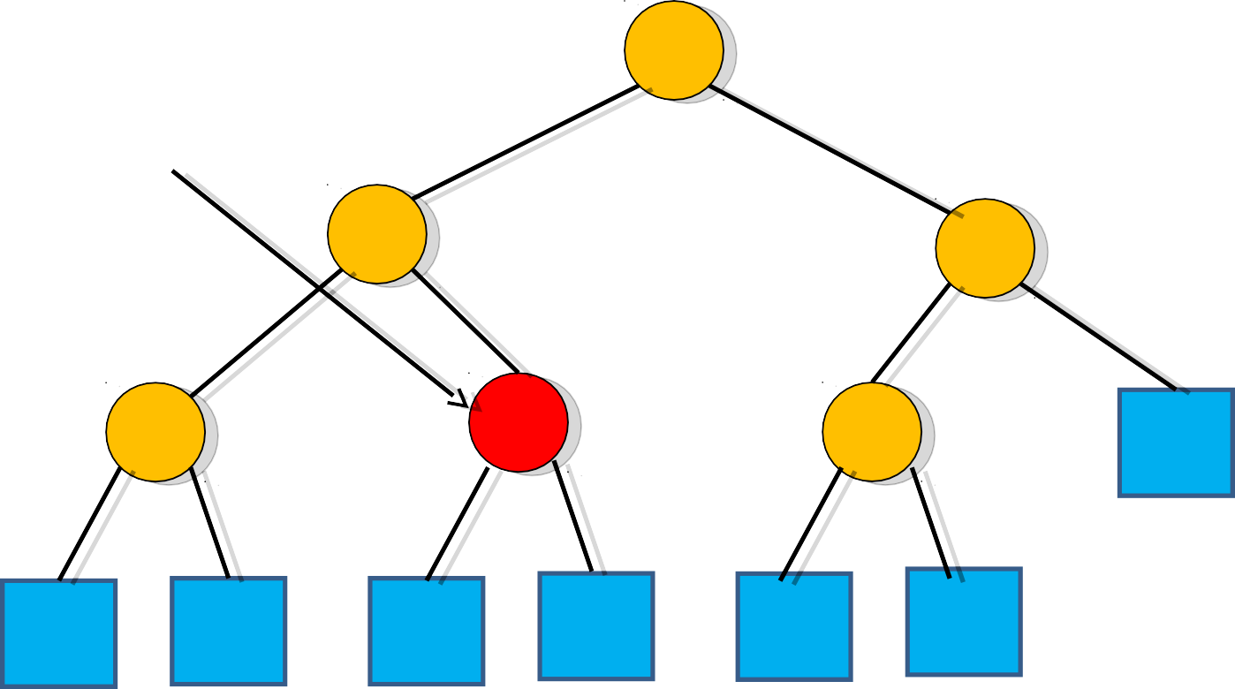
Binary Tree Search Algorithm
Example: k =4 and x=root.left.right Call TREE-SEARCH(x,4)
6
x=root.left.right
2
Now x.key=4 then k=x.key Search terminates
9
1
4
8

Slide 29
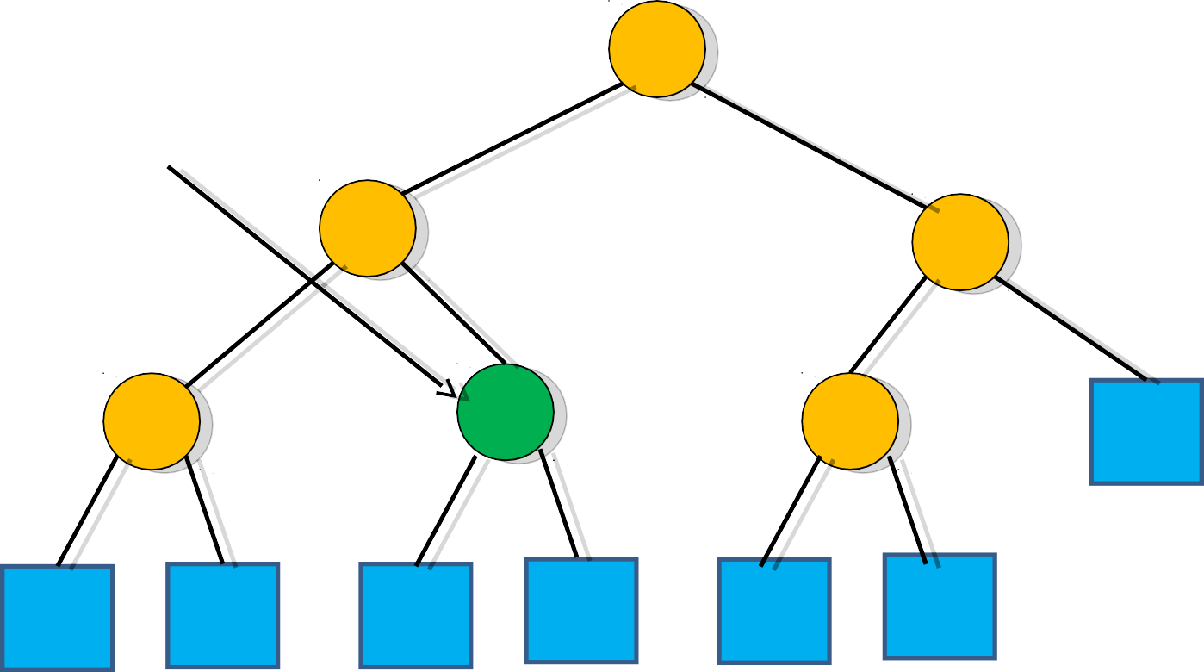
Binary Tree Search Algorithm
Example: k =4 and x=root.left.right Now x.key=4 then k=x.key
6
x=root.left.right
2
Search terminates and x=root.left.right is the desired
node or location
9
1
4
8

Slide 30
Search in a BST: C code
Ptnode search(ptnode root,
int key)
{
/* return a pointer to the node that
contains key. If there is no such node, return NULL */
if (!root) return NULL;
if (key == root->key) return root; if (key < root->key)
return search(root->left,key); return search(root->right,key);
}

Slide 31
Minimum Key or Element
We can always find an element in a binary search tree whose key is minimum by following the left children from the root until we encounter a NIL.
Otherwise if a node x has no left subtree then the value x.key contained in root x is the minimum key or element. The procedure for finding the minimum key:
TREE-MINIMUM(x)
while x.left ≠ NIL
x = x.left
return x

Slide 32
Maximum Key or Element
We can always find an element in a binary search tree whose key is maximum by following the right children from the root until we encounter a NIL.
Otherwise if a node x has no right subtree then the value x.key contained in root x is the maximum key or element. The procedure for finding the maximum key:
TREE-MAXIMUM(x)
while x.right ≠ NIL
x = x.right
return x

Slide 33
Insert a value into the BST
To insert a new value v into a binary search tree T, we use the procedure TREE-INSERT.
The procedure takes a node z for which z.key=v , z.left=NIL and z.right=NIL.
It modifies T and some of the attributes of z in such a way that it inserts z into an appropriate position in the tree

Slide 34
Insert a value into the BST
♣
TREE-INSERT(T , z)
y=NIL
x= T.root
While x ≠ NIL
4.
5.
6.
7.
8. z.p=y
y=x
if z.key<x.key x=x.left
else x=x.right
if y== NIL
T.root = z
elseif z.key < y.key
12. y.left=z
13.else y.right = z

Slide 35
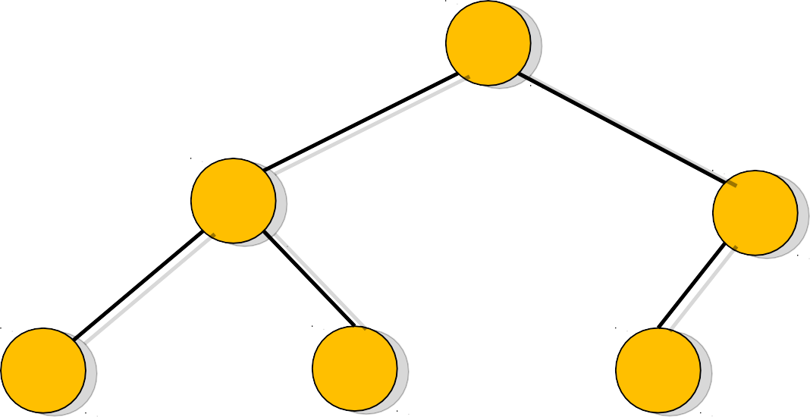
BST Insertion Algorithm
We are supposed to insert
6
an item value 5 and find an appropriate node z for it
9
2
11
4
8

Slide 36
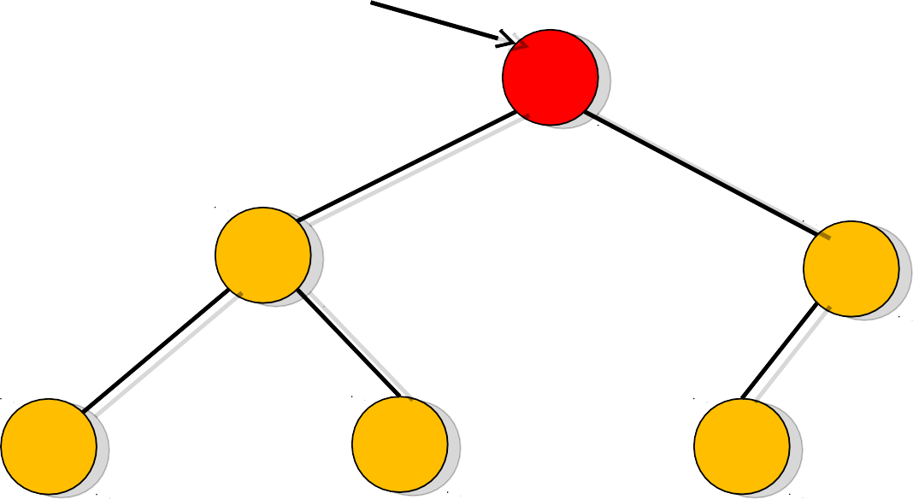
BST Insertion Algorithm
x=T.root
Y=NIL and x=T.root
6
2
9
11
4
8

Slide 37
BST Insertion Algorithm
x=T.root
Now x≠NIL and z.key<x.key
6
That is [5<6]
2
9
11
4
8

Slide 38
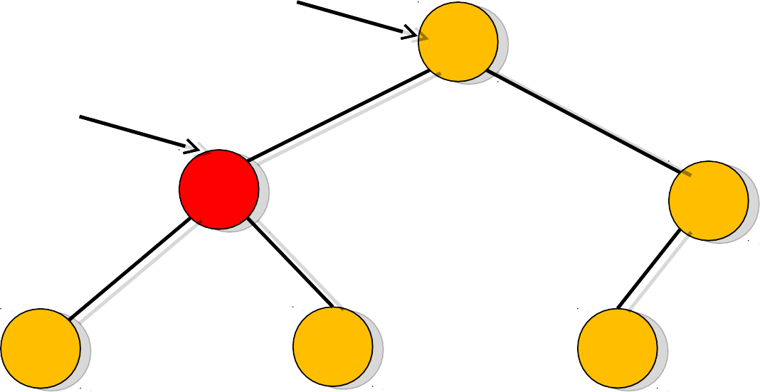
BST Insertion Algorithm
y
Y=T.root and x=T.root.left And z.key>x.key[5>2]
6
x
2
9
11
4
8

Slide 39
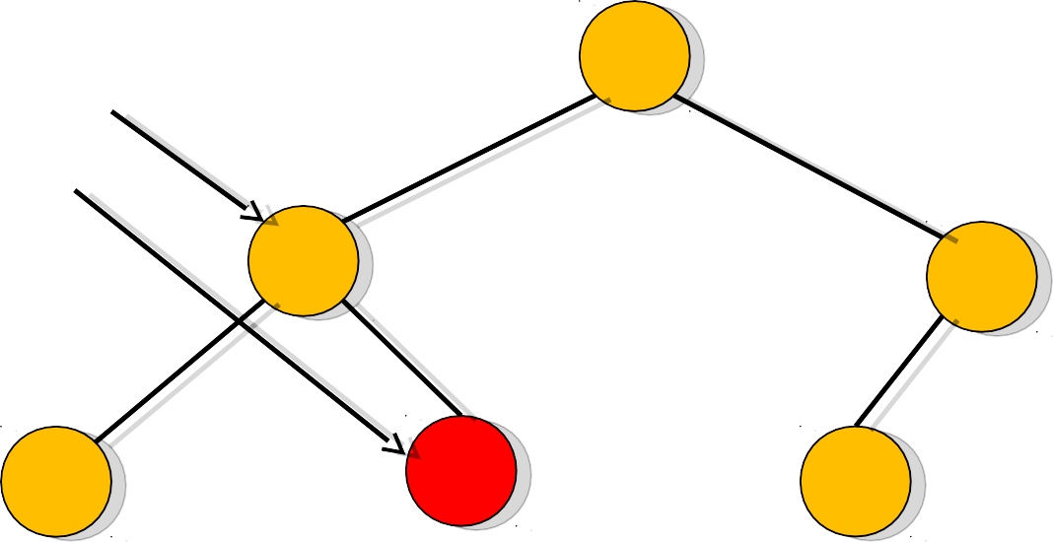
BST Insertion Algorithm
Y=T.root.left and
y x
6
x=T.root.left.right And z.key>x.key[5>4]
9
2
11
4
8

Slide 40
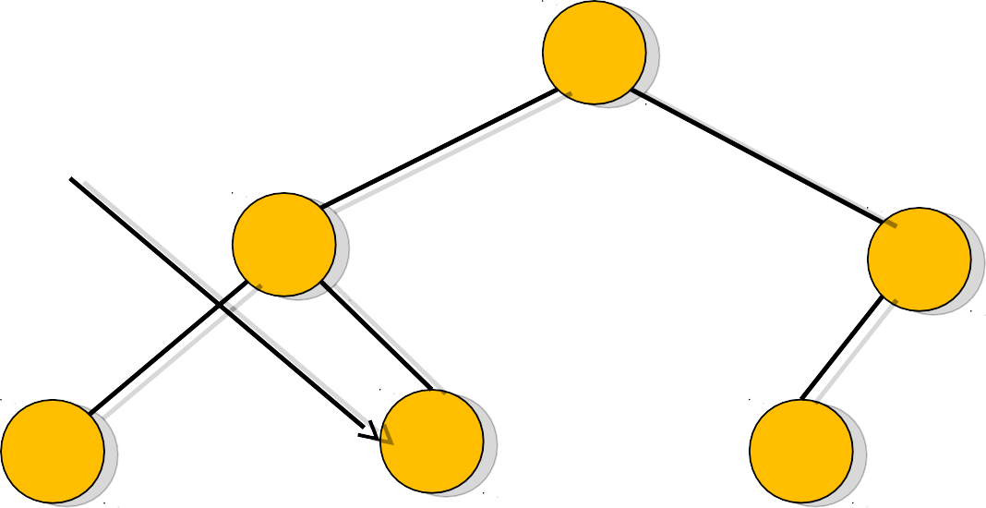
BST Insertion Algorithm
Y=T.root.left.right and x=NIL
6
Then z.p=T.root.left.right
y
2
9
11
4
8

Slide 41
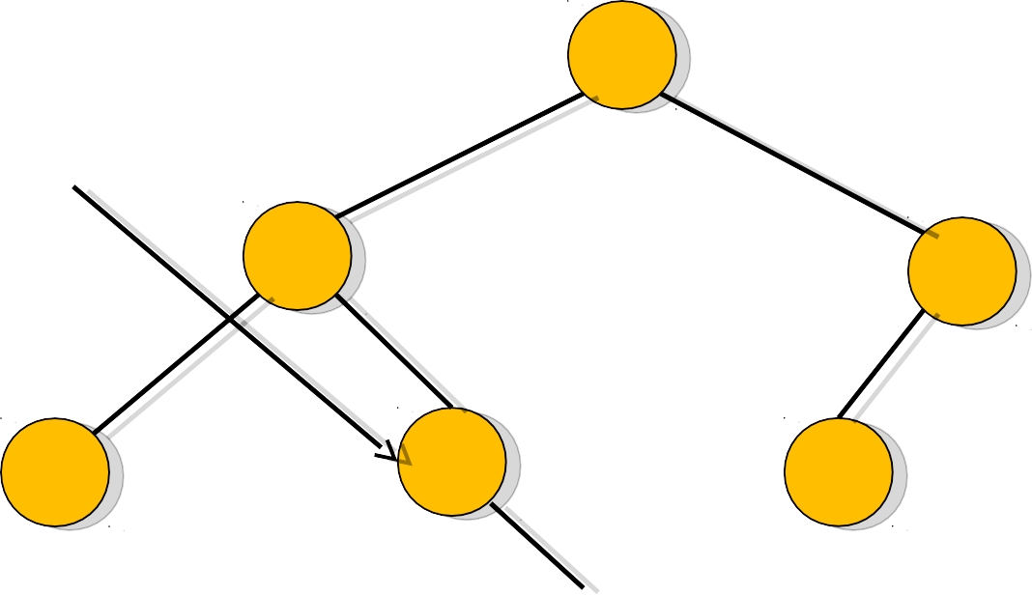
BST Insertion Algorithm
Y=T.root.left.right [y ≠ NIL] And z.key>y.key [5>4]
6
So y.right=z that is T.root.left.right.right=z
9
y
2
11
z
4
8
5

Slide 42
Insertion in BST – Pseudo code
if tree is empty
create a root node with the new key else
compare key with the top node if key = node key
replace the node with the new value else if key > node key
compare key with the right subtree:
if subtree is empty create a leaf node else add key in right subtree
else key < node key
compare key with the left subtree:
if the subtree is empty create a leaf node else add key to the left subtree

Slide 43
Insertion into a BST: C code
void insert (ptnode *node, int key)
{
ptnode ptr,
temp = search(*node, key); if (temp || !(*node)) {
ptr = (ptnode) malloc(sizeof(tnode)); if (IS_FULL(ptr)) {
fprintf(stderr, “The memory is full\n”); exit(1);
}
ptr->key = key;
ptr->left = ptr->right = NULL; if (*node)
if (key<temp->key) temp->left=ptr; else temp->right = ptr;
else *node = ptr;
}
}

Slide 44
Delete a value from the BST
♣
Removing a node from a BST is a bit more complex, since we do not want to create any "holes" in the tree. The intention is to remove the specified item from the BST and adjusts the tree

Slide 45
Delete a value from the BST
Experimenting the cases:
if the tree is empty return false
else Attempt to locate the node containing the target using the binary search algorithm:
if the target is not found return false
else the target is found, then remove its node. Now while removing the node four cases may happen

Slide 46
Delete a value from the BST
Case 1: if the node has 2 empty subtrees
- replace the link in the parent with null
Case 2: if the node has a left and a right subtree
replace the node's value with the max value in the left subtree
delete the max node in the left subtree
Case 3: if the node has no left child
link the parent of the node to the right (non-empty) subtree
Case 4: if the node has no right child
link the parent of the target to the left (non-empty) subtree

Slide 47
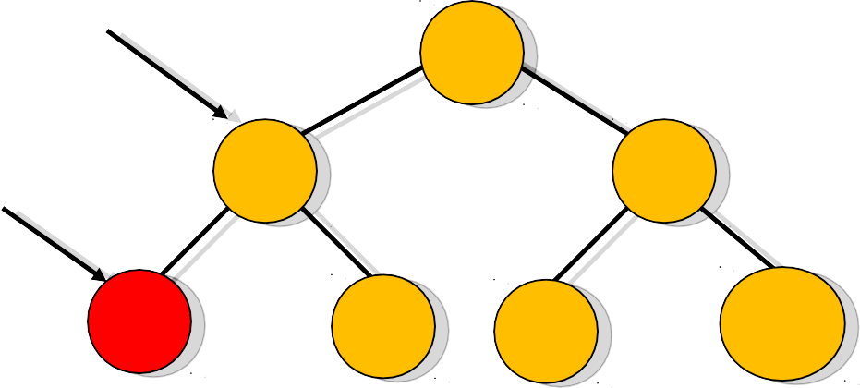
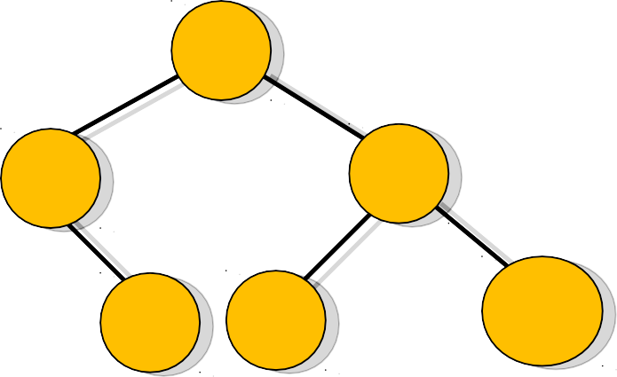
Delete a value from the BST
Case 1: removing a node with 2 EMPTY SUBTREES
-replace the link in the parent with null
Removing 4
Parent
7 7
5 9
5
9
Z
4
6
8
1100
6
8
1100

Slide 48
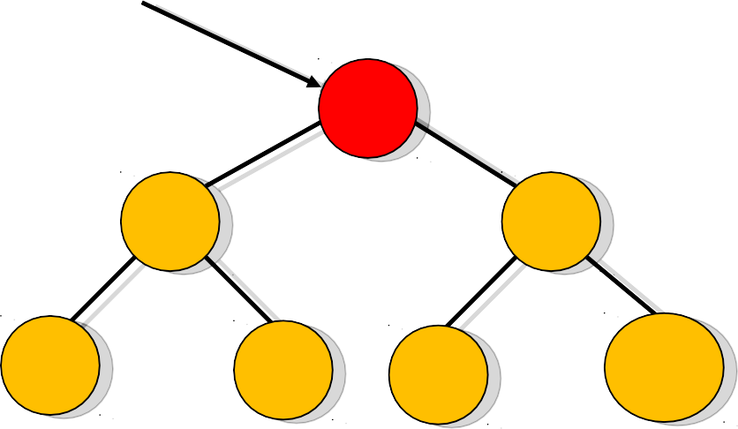
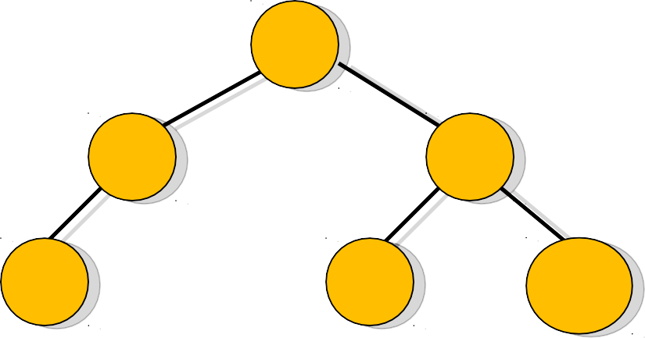
Delete a value from the BST
Case 2: removing a node with 2 SUBTREES
replace the node's value with the max value in the left subtree
delete the max node in the left subtree
Z
Removing 7
7
6
5
9
5
9
4
6
8
1100
4
8
1100

Slide 49
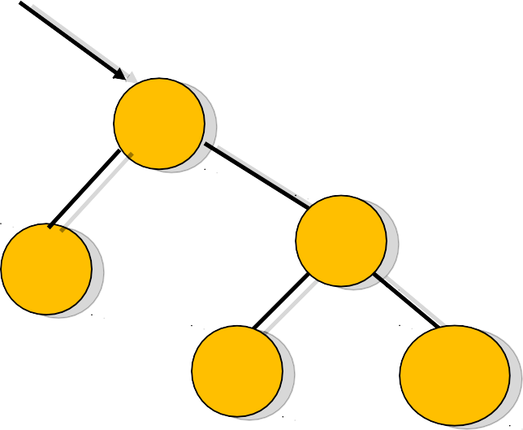
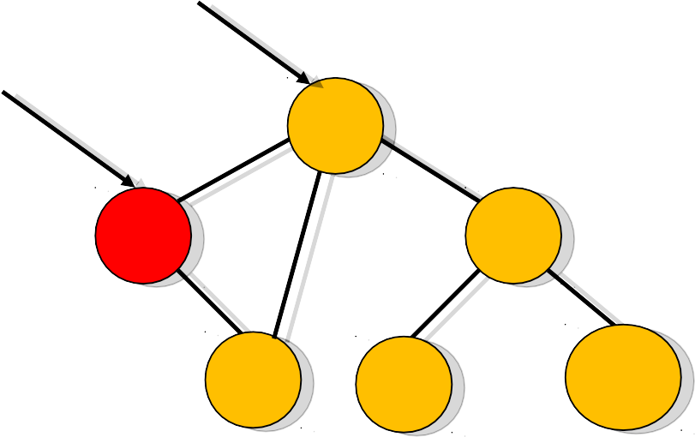
Delete a value from the BST
Case 3: if the node has no left child
- link the parent of the node to the right (non-empty) subtree
Parent
Removing 5
Parent
Z
7
7
5
9
9
6
6
8
1100
8
1100

Slide 50
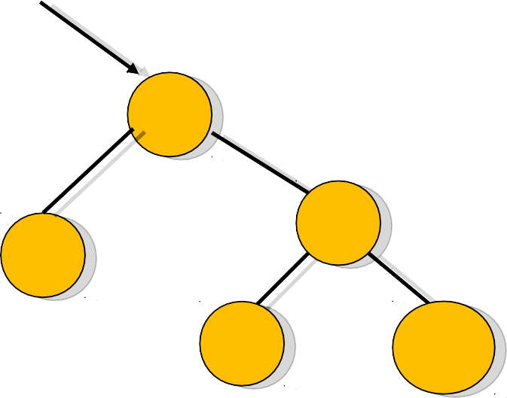
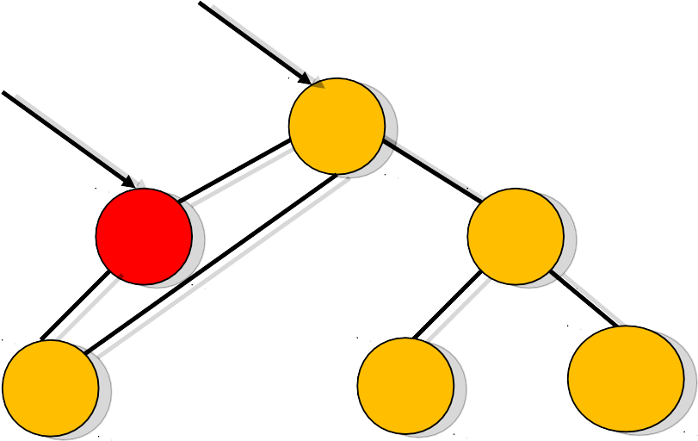
Delete a value from the BST
Case 4: if the node has no right child
- link the parent of the node to the left (non-empty) subtree
Parent
Removing 5
Parent
Z
7
7
5
9
9
4
4
8
1100
8
1100

Slide 51
BST Deletion Algorithm
•
TREE-DELETE (T, z)
if left [z] = NIL .OR. right[z] = NIL
then y ← z
else y ← TREE-SUCCESSOR (z)
if left [y] ≠ NIL
then x ← left[y]
else x ← right [y]
if x ≠ NIL
then p[x] ← p[y]
if p[y] = NIL
then root [T] ← x
else if y = left [p[y]]
then left [p[y]] ← x
else right [p[y]] ← x
if y ≠ z
then key [z] ← key [y]
if y has other field, copy them, too
return y

Slide 52
Analysis of BST Operations
The complexity of operations search, insert and
remove in BST is O(h) , where h is the height.
When the tree is balanced then it is O(log n). The updating operations cause the tree to become unbalanced.
The tree can degenerate to a linear shape and the operations will become O (n)

Slide 53
Applications for BST
♣
Binary Search Tree: Used in many search applications where data is constantly entering/leaving, such as the map and set objects in many languages' libraries.
Binary Space Partition: Used in almost every 3D video game to determine what objects need to be rendered.
Binary Tries: Used in almost every high-bandwidth router for storing router-tables.
Heaps: Used in implementing efficient priority-queues. Also used in heap-sort.
Huffman Coding Tree:- used in compression algorithms, such as those used by the .jpeg and .mp3 file-formats.
GGM Trees - Used in cryptographic applications to generate a tree of pseudo-random numbers.
Syntax Tree: Constructed by compilers and (implicitly) calculators to parse expressions.
♣
♣
♣
♣
♣
♣

Slide 54
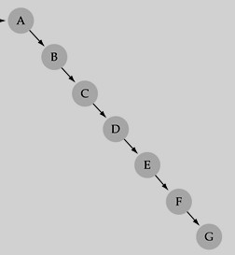
What is a Degenerate BST?
A degenerate binary search tree is one where most or all of the nodes contain only one sub node.
It is unbalanced and, in the worst case, performance degrades to that of a linked list.
If your add node function does not handle rebalancing, then you can easily construct a degenerate tree by feeding it data that is already sorted.

Slide 55
Does the order of inserting elements into a tree matter?
Yes, certain orders might produce very unbalanced trees or degenerated trees!
Unbalanced trees are not desirable because search time increases!
♣
Advanced tree structures, such as red-black trees, AVL trees, guarantee balanced trees.

Slide 56
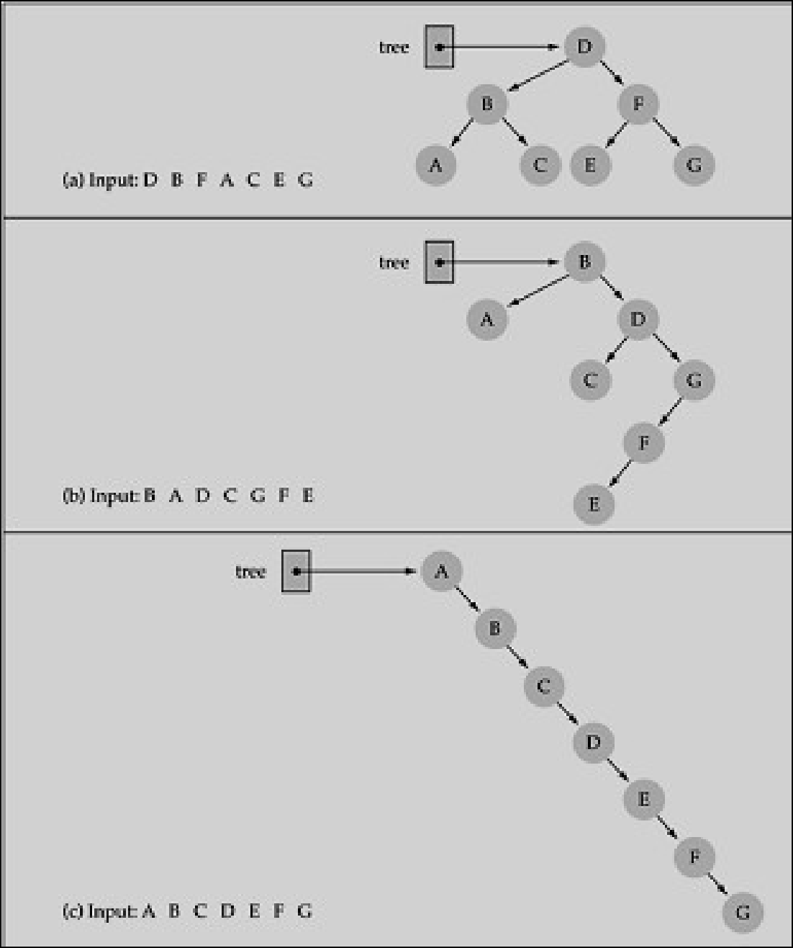
Does the order of inserting elements into a tree matter?

Slide 57
Better Search Trees
Prevent the degeneration of the BST :
A BST can be set up to maintain balance during updating operations (insertions and removals)
Types of ST which maintain the optimal performance in other words balanced trees:
splay trees
AVL trees
2-4 Trees
Red-Black trees
B-trees

Slide 58
References
Introduction to Algorithms by Thomas H. Cormen and others
Binary Search Tree by Penelope Hofsdal Rada Mihalcea
♣
♣
♣
http://www.cs.unt.edu/~rada/CSCE3110

